Slide 1
Welcome to 5th Grade at Margaret!
When you see an , click on the image it is pointing to!
Notes:
Tracy welcomes and gives instructions.

Slide 2
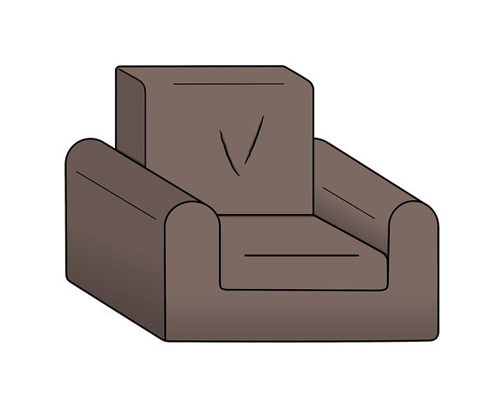
5th grade teachers welcome you!
Hi! I’m Mrs. Wilkinson. I teach Reading, Language, and History.
And I’m Mrs. Zielke. I also teach Reading, Language, and History.
Notes:
Lori and then Tracy.

Slide 3
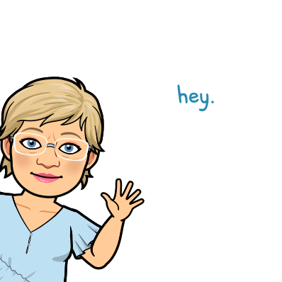
5th grade teachers welcome you!
Hello! I’m Mrs. Cramer. I teach math and history!!!
And I’m Mrs. Smith. I teach Science, History, and Health.
Hello! I’m Mrs. Tennant. I teach Math, Science and Health.
Notes:
1. Hope 2. Caitlyn 3. Wendy

Slide 4
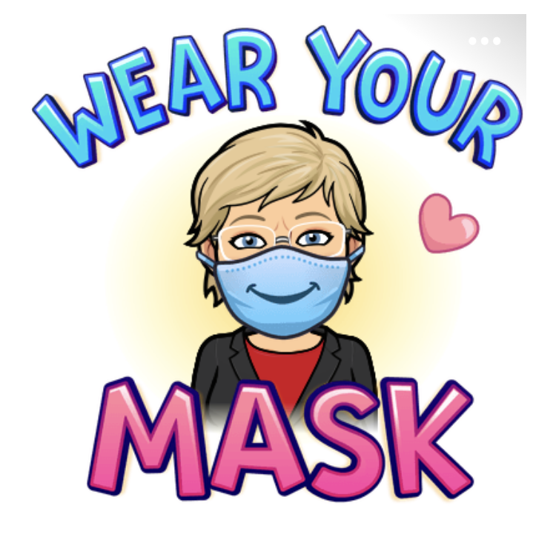
COVID
Considerations
Notes:
Caitlyn

Slide 5
BINDERS / TRAPPER KEEPERS
Binder Organization
Red communication folder –cont.
Pencil Pouch
“Return to School” – papers
that need signed and
returned – including ALL
Ds and Fs.
Any items from the pencil
pouch used at home need
to be returned to pouch.
Agenda
Red communication folder
Daily/Weekly assignments
found here.
Conduct Sheet front
(Please DO NOT remove!)
NO SIGNATURE REQUIRED!
User name / Password Sheet
“Keep at Home” – papers
that need to remain at
home.
Please keep this in the
binder.
Notes:
Hope

Slide 6
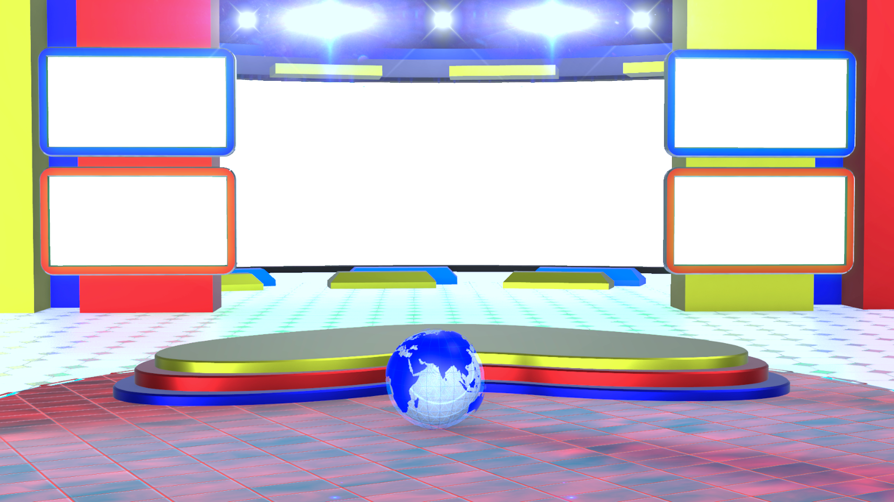
Weekly Newsletters
Sent weekly though
emails by each
homeroom teacher.
TEACHER EMAILS:
caitlyn.smith@sccboe.org
wendy.cramer@sccboe.org
hope.tennant@sccboe.org
lori.wilkinson@sccboe.org
tracy.zielke@sccboe.org
Teacher’s Websites
A great place to find
pertinent information.
sccboe.org/maes
(Click on the “teacher” tab.)
Notes:
Wendy

Slide 7
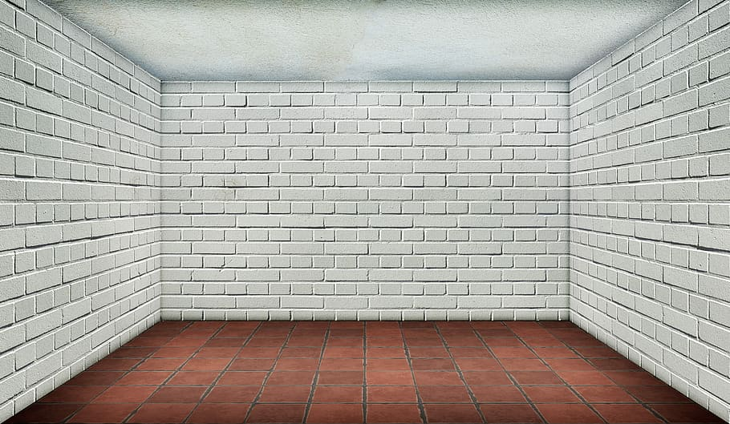
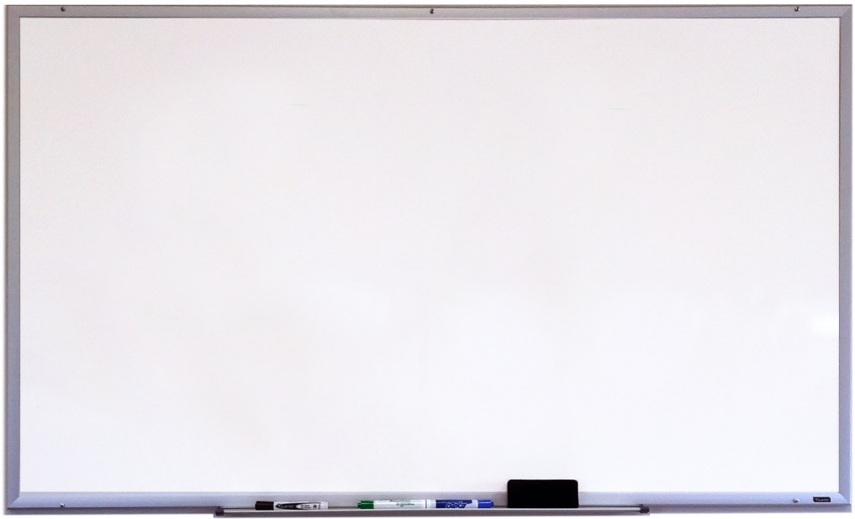
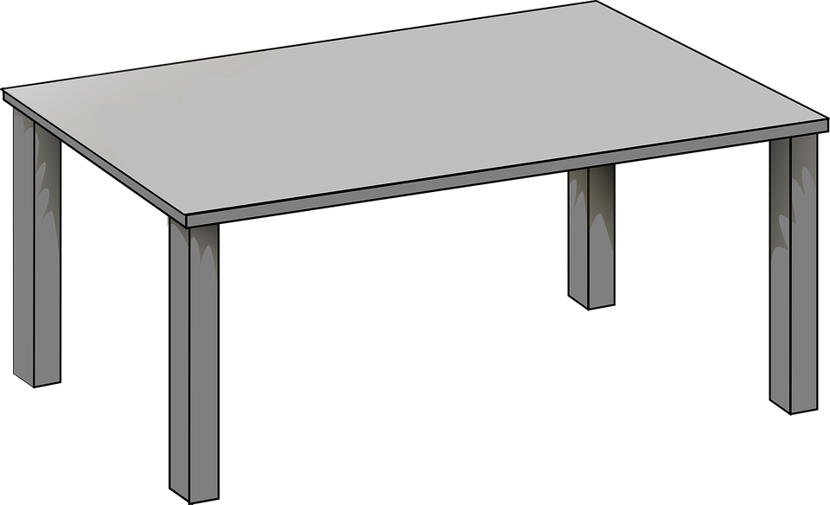
Beyond the Classroom– HOW TO
If you want to see your child’s grades, check
i-Now once a week. Grades are only updated once a week.
Go to www.sccboe.org/maes
2) Click on “For Students.”
3) Click on OFFICE 365.
4) Outlook APP - email
5) TEAMS APP – where assignments can be found.
Notes:
Tracy

Slide 8
Grade Weights
TESTS: 60%
QUIZZES: 30%
Class work/
Homework : 10%
i-Now
Grading
Notes:
Wendy

Slide 9
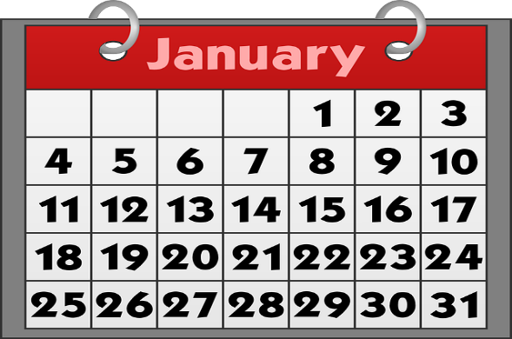
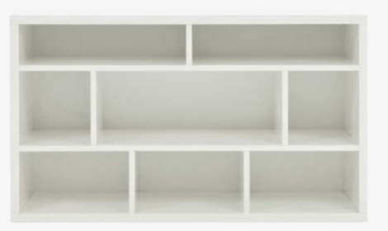
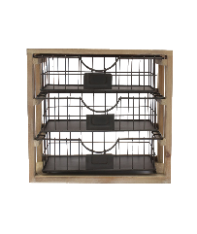
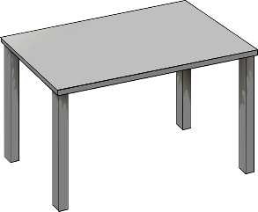
If you need to contact your child’s homeroom teacher with important information such as a transportation change, please email all contact teachers for your child.
Please let your child’s homeroom teacher AND the additional contact teacher(s) know of transportation changes by email no later than 1:30 p.m.
This Week
august
CONTACTING TEACHERS!
Email them!
If you do not hear back from them, please call the office to let them know.
----
-------------------------------
Contact teachers for your child:
Tennant & Zielke
OR
Smith / Cramer/Wilkinson
--------
--------
--------
--------
Stride
REFLEX
Notes:
Caitlyn

Slide 10
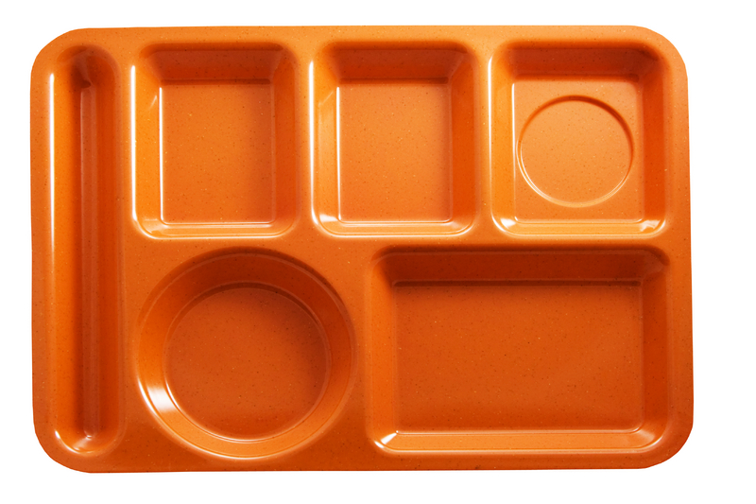
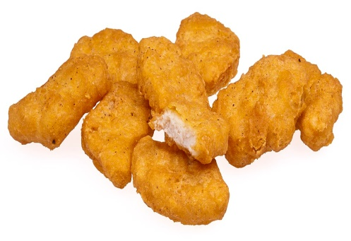
MUSTANG CAFETERIA and SNACK
Sadly, parents cannot come eat with us at this time!
Because of COVID, we are eating lunch in our classrooms!
Notes:
Lori (or Hope if Lori isn’t there)

Slide 11
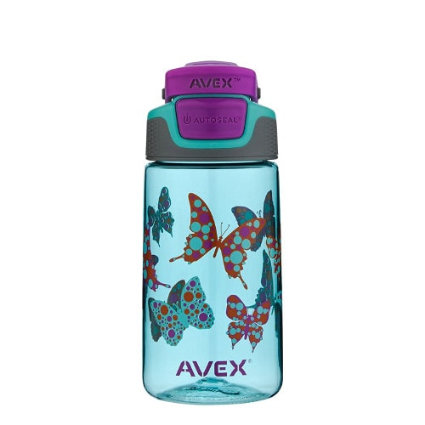
SNACK
Bring
your own
snack!
HEALTHY
snacks &
water
We prefer
water bottles
with
flip lid!
TIME
Please write your child’s first and last name on the water bottle!
Notes:
Tracy

